Slide 1
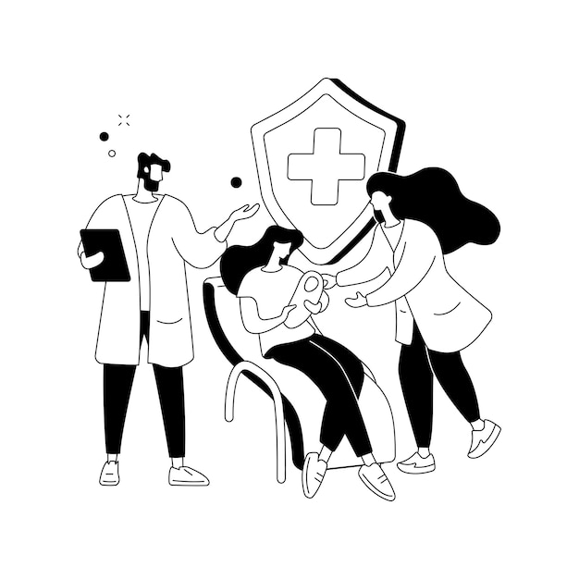
Design thinking and idea lab
MATERNITY CARE SYSTEM

Slide 2

Team introduction Inovate X-creation
SARTHAK SANDHAN
RUSHIKESH PATIL
SHRAVANI UNDE
ABHISHEK AGRE
VEDANT GAWALI
PANKAJ GADE

Slide 3
Topic selection
Clear Definition :-State the problem you re trying to solve
We have observed that every women in her Maternity phase goes under lots of pains and problems.
In the long period of 9 months they of gr live in so uncomfortable situation
Those women are not able to do their another work happily & properly
Society ignores this problems by thinking that its common for every women .
The stretching they feel for 9 months and pain after delivery stiches is unimaginable
So, to help such women by our technology we have chosen this topic.
This problem is leading into the sadness of half society.
Women are changing their thought in negative way
.

Slide 4
In Business Perspective
Maternity products can make a lot of profit. Because the rich party i.e. Hospitals are also one of the end users.

Slide 5
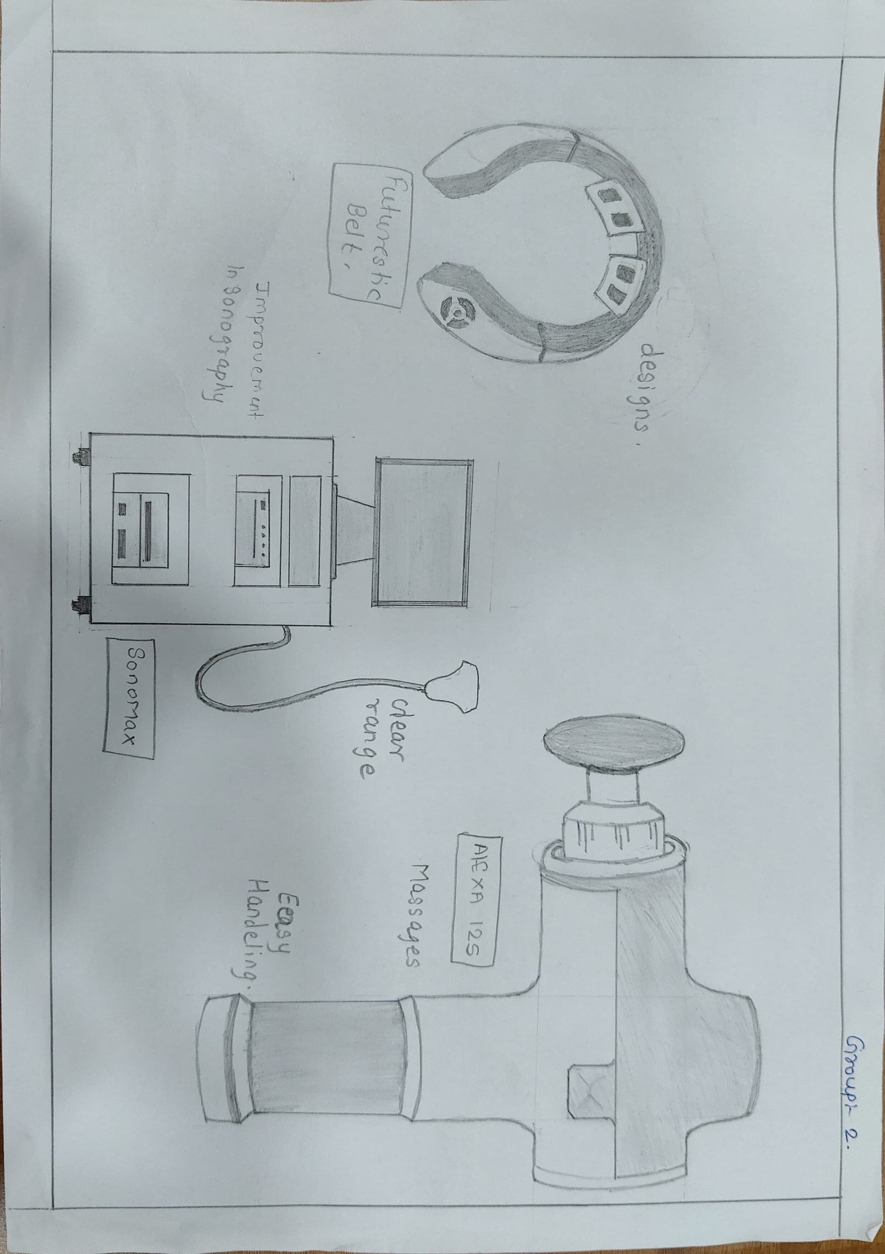
DIAGRAM

Slide 6
Persona construction
End user:- Doctor
Motivation
To do safe delivery of Pregnant women.
Using latest technology to give safest treatment
During all the work and responsibilities having Family support.
Background
Obviously from rich background and wealthy Family.
Obviously well educated.
Hard working and wanted to give best facilities to there patients.
May be have own hospital or working in big hospital.
May be have a big family or nuclear family.
Challenges Faced
To manage family and their very responsible work.
To manage patients safely.
To maintain the stability of mind while handling the patients.
To give best treatment to pregnant women.
Having lot of pressure and trust on him .
Doubts / Fears
Can he do his work properly and give the safest treatment. (Doubts)
To maintain the good health of pregnant women during Delivery.
Aspiration
To serve the nation.
To be best doctor.
To have big hospital To do safe delivery. or big Salary
To do safe delivery
The doctors profession having very responsibilities, and having various types of challenges to handle the pregnant women. He has aspirant to do his work properly. The doctor gives his hundred percent to do the safe delivery of pregnant woman. To be a doctor is not a simple thing.

Slide 7
Persona construction
End user:- Maternity Women
Background
May be they are middle class or poor or from rich family.
May be they are well educated or non-educated
May be they have a good facilities or having low facilities
May be they are working women or housewife
Challenges Faced
To manage family and their very responsible work.
To manage patients safely
To maintain the stability of mind while handling the patients.
To give best treatment to pregnant women.
Having lot of pressure and trust on re and trust on him.
Motivation
To have a child.
The developing technology to reduce their pain.
To have family support.
Doubts / Fears
To have a lot of pain. (fear)
To maintain fitness after delivery. (fear)
To having a good delivery. (doubt)
Aspiration
To have. a good child.
To be a good Mother.
To have a good job.
To have a good future.
The maternity woman may be is from higher or lower background have same challenges of before pregnancy and after pregnancy. But still they are happy to be a good mother but has a fear of delivery , Body pain and fitness. But still they have aspiration to be good mother and have food job

Slide 8
AFFINITY MAPPING
Delivery,
pregnancy,
child birth,
birth planning,
women's health,
family planning,
baby,
mother,
nurse,
doctor,
hospital,
care,
support,
clinic,
exercise,
month of pregnancy,
slow walking,
baby wearing
checkup,
toys,
parenthood,
vaccination,
development,
child psychology,
new life,
boy,
girl,
guiding,
little one,
mental health,
baby growth,
feeding,
motherhood,
happiness,
technology
BP
.

Slide 9
.
Women
,doctor,
pain /problems
,future problems
,psychology,
fear ,
happiness ,
problem ,
mom ,
house,
management ,
delivery,
family,
society,
mental health child ,
care ,
treatment ,
operation
,parematinty post ,
maternity
,hospital
,medical,
nurses ,
technology
,practice,
leg pain
,back pain,
surgery
,hair fall ,
,sugar ,
kidney pain ,
participations,
contractions,
postpartum
,restrictions no rise ,
no spice
nutrition diet
,healthy food
,allergies
,attacks ,
knee pain,
acidity
,improvement
,personality
,independencies,
self time
,ignorance,
depression.
.

Slide 10
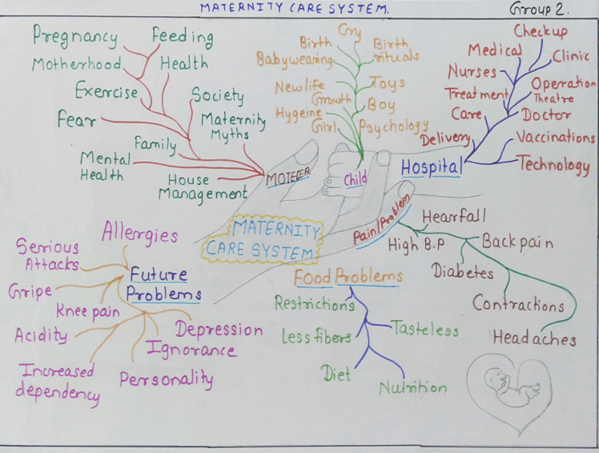

Slide 11
MATRIX ( who, what, where, when, why, how)
 |  | Mother | Child | Hospital | Problems/Pains
Who | Who is taking care of it? | All the women are so careful of their maternity, time period | After delivery the body becomes more sensitive so care of them is most require by mom and family | Hospitals have the responsibility to take care of both Mother and child | Government and society has to be careful about Maternity.
Why | Why they are ignoring problems? | Due to lack of self time may be they are not focusing and ignoring their problems. | Due to so called growth Compitetion ,there problems are getting ignored | May be due to improper management or coordination of the team , the problems are ignore | Ignoring ,by thinking its normal to everyone
What | What problems they are facing ? | Women are ignoring their health ,getting serious problems like Hair fall, High B.P, Diabetes | Improper feeding and hygiene problems | Insufficient staff, family pressure, Risk for critical situation | Insufficient management , Ignorance and old thoughts .
When | When the solution will develop? | The day when they will get the proper time | The day when they will get the proper time | The moment when hospital will take the help of Developed technology | By proper analysis of problems
Where | Where can we update or develop the terms? | Considering their comfortness | Focusing on their future | In the Operation and counselling ,Developed machines can be include | To reduce pain of stiches Machines can be made
How | How can we help them and to resolve their problem? | By using our technical knowledge to serve them | By giving them priority | By updating the technologies related to medical field | By enhancing the technology with the combination of AI and Machine Learning .

Slide 12
THANK YOU

